Slide 1
MICROSOFT SCHAFFT SICH AB
#SNEAKPREVIEW
https://vimeo.com/298471980/3fae5db41e

Slide 2
THORSTEN
BUTZ
MICROSOFT
SCHAFFT
SICH AB
Wie wir unsere Infrastruktur
aufs Spiel setzen
GEEKMANIA

Slide 3


Gold-Sponsor:
Silver-Sponsor:

Slide 4
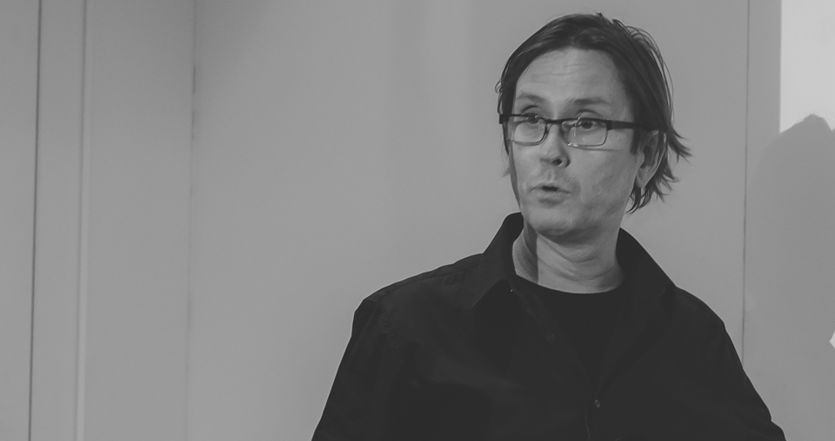
THORSTEN
BUTZ
senior technical fellow

Slide 5
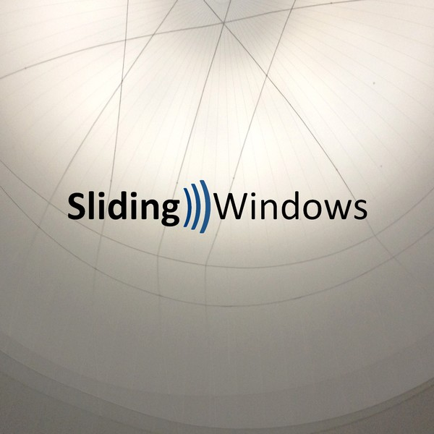

PODCAST: Sliding Windows
www.slidingwindows.de/?feed=slw-mp3
Rolf Masuch
Helge Klein
André Aulich
Bruce Payette
Benny Tritsch
Daniel Fett
Guido Schmitz
Joey Aiello
Bartek Bielawski
Sami Laiho
Nils Kaczenski
Jeffrey Snover
Uwe Stoll

Slide 6
# 1
Eine Geschichte voller Missverständnisse

Slide 7
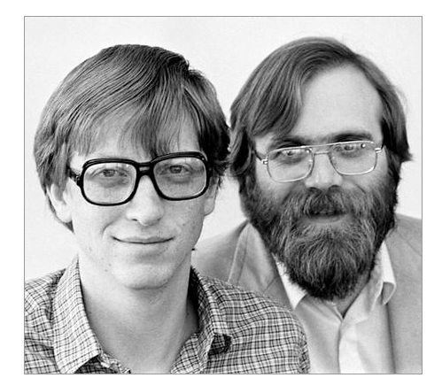
1975
Notes:
Screenshot from: https://www.wired.com/2008/04/dayintech-0404/

Slide 8
1978
TITLE BASIC M6502 8K VER 1.1 BY MICRO-SOFT
SEARCH M6502
SALL
RADIX 10 ;THROUGHOUT ALL BUT MATH-PAK.
$Z:: ;STARTING POINT FOR M6502 SIMULATOR
ORG 0 ;START OFF AT LOCATION ZERO.
SUBTTL SWITCHES,MACROS.
REALIO=4 ;5=STM
;4=APPLE.
;3=COMMODORE.
;2=OSI
;1=MOS TECH,KIM
;0=PDP-10 SIMULATING 6502
INTPRC==1 ;INTEGER ARRAYS.
ADDPRC==1 ;FOR ADDITIONAL PRECISION.
LNGERR==0 ;LONG ERROR MESSAGES.
Notes:
Microsoft BASIC for 6502 Original Source Code [1978]
https://www.pagetable.com/?p=774

Slide 9
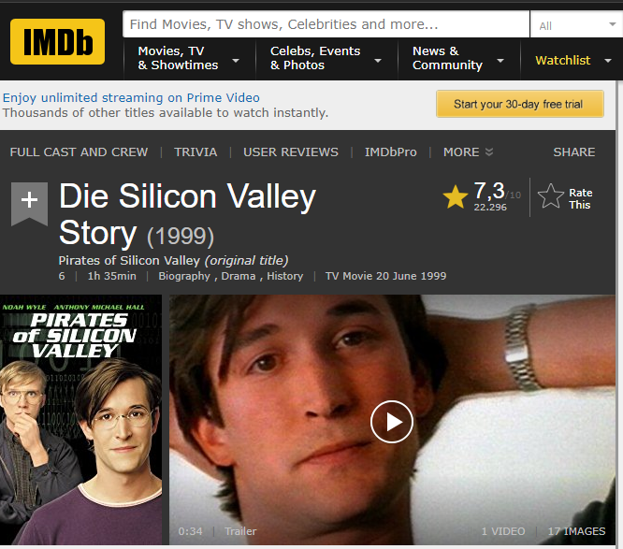
Pirates of Silicon Valley, 1999
Notes:
https://www.imdb.com/title/tt0168122/

Slide 10
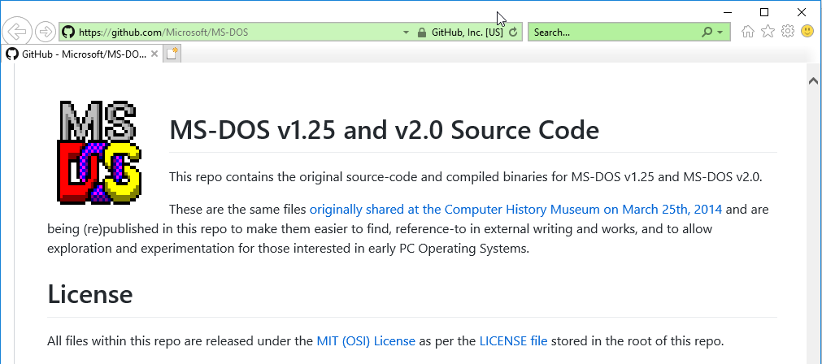
Notes:
Screenshot from: https://www.wired.com/2008/04/dayintech-0404/

Slide 11
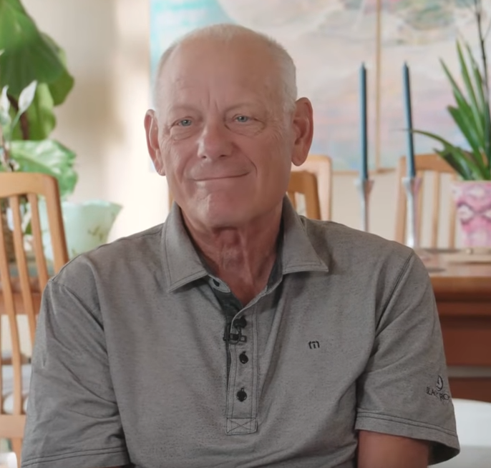
Notes:
Oral History of Dave Cutler Part 1
https://www.youtube.com/watch?v=29RkHH-psrY
@DEC 1971-1988
@MSFT: 1988-heute

Slide 12


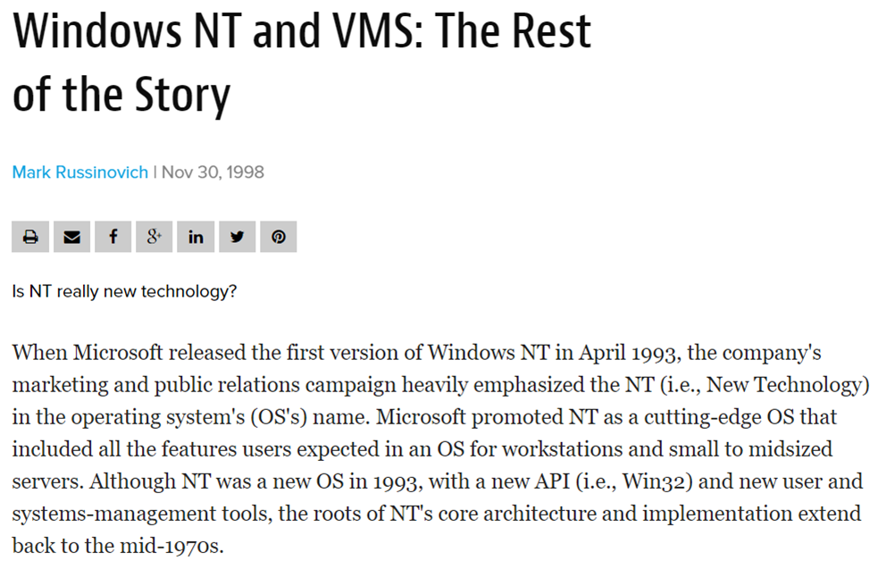
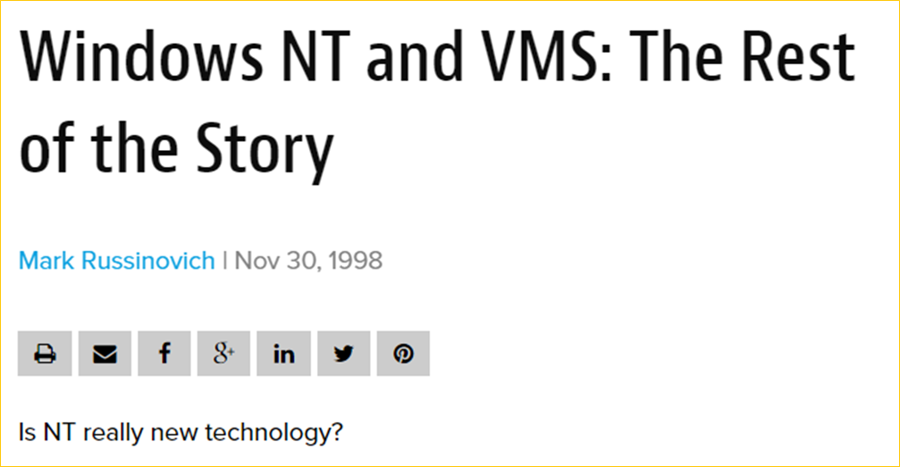
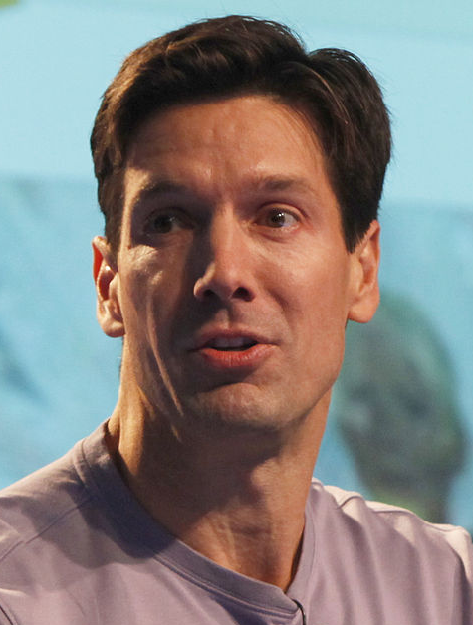
Notes:
https://www.itprotoday.com/compute-engines/windows-nt-and-vms-rest-story
https://de.wikipedia.org/wiki/Mark_Russinovich#/media/File:Mark_Russinovich.jpg

Slide 13
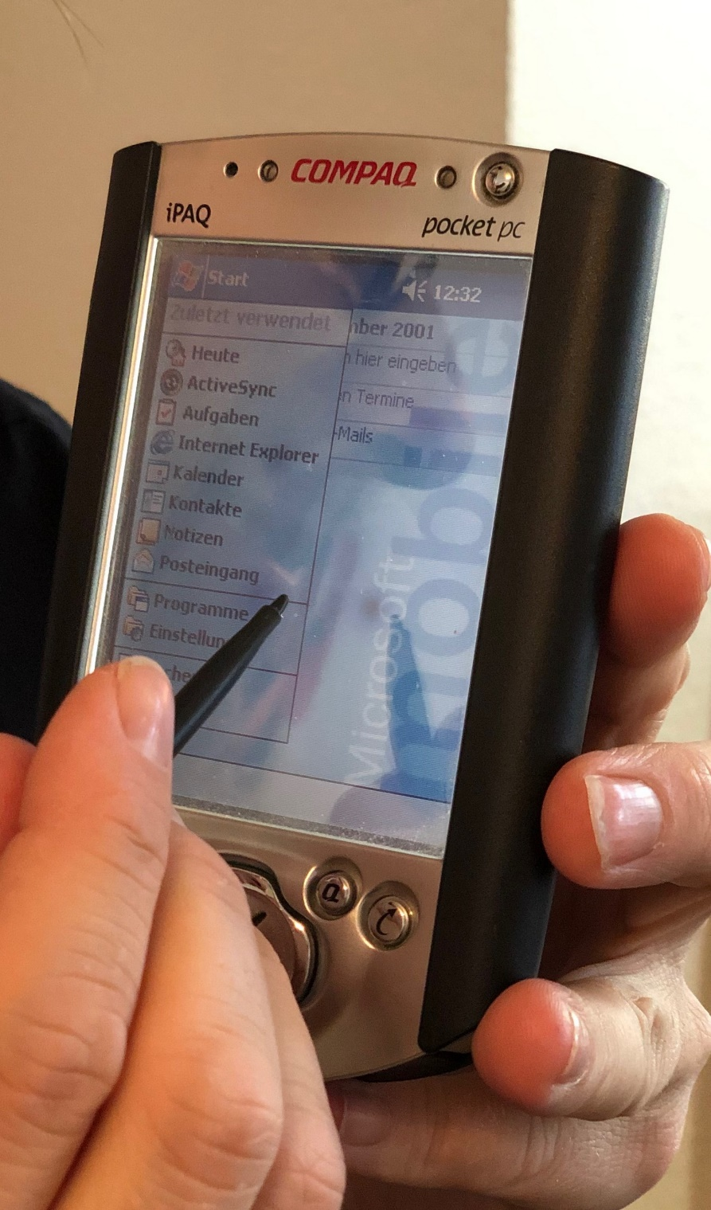
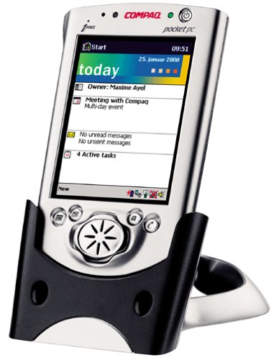
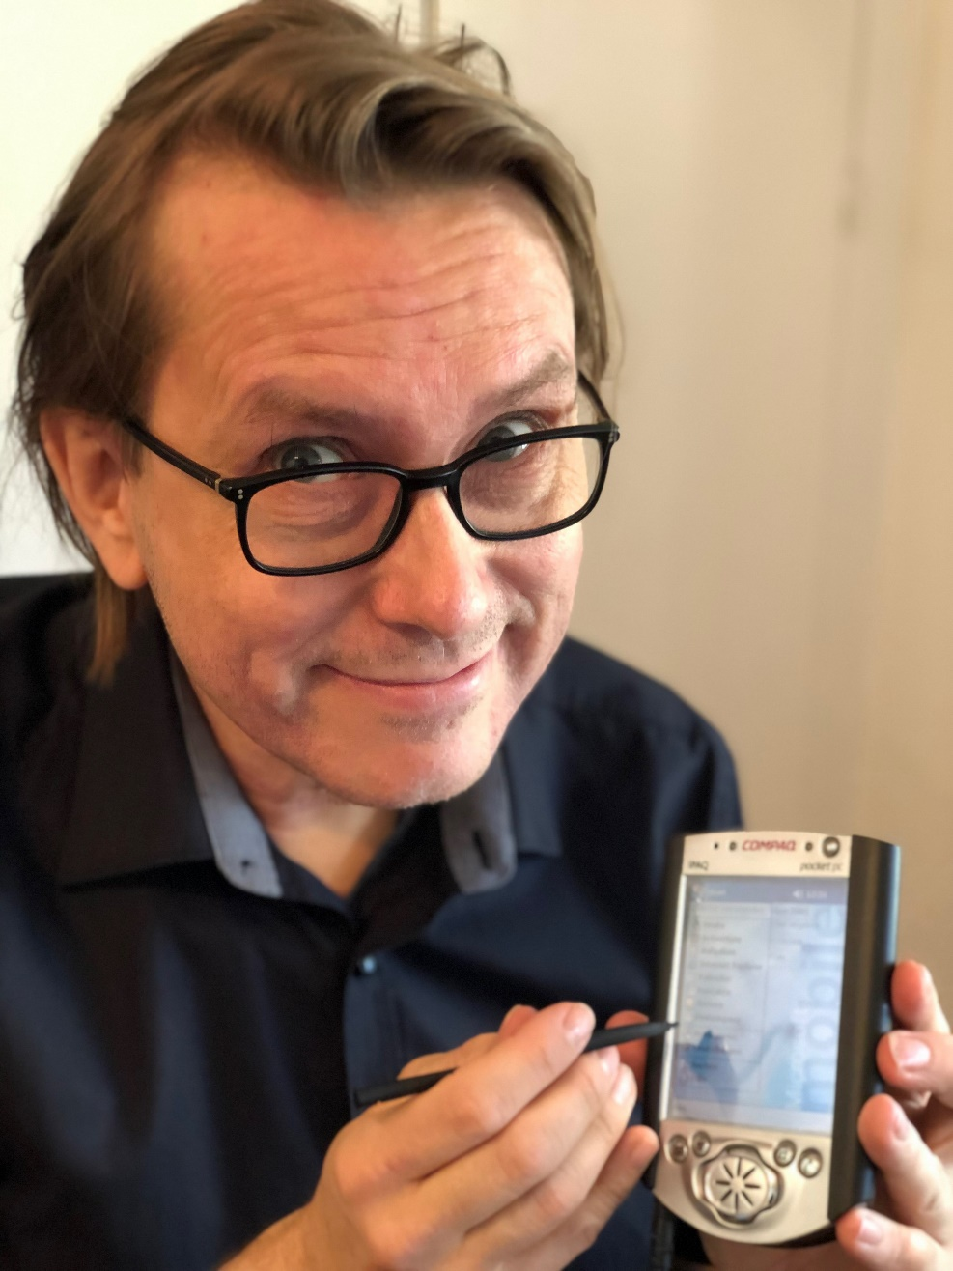
2001
Notes:
2010 - 2011
https://en.wikipedia.org/wiki/Microsoft_Kin

Slide 14

2006
Notes:
2006-2011

Slide 15

2010
Notes:
2010 - 2011
https://en.wikipedia.org/wiki/Microsoft_Kin

Slide 16
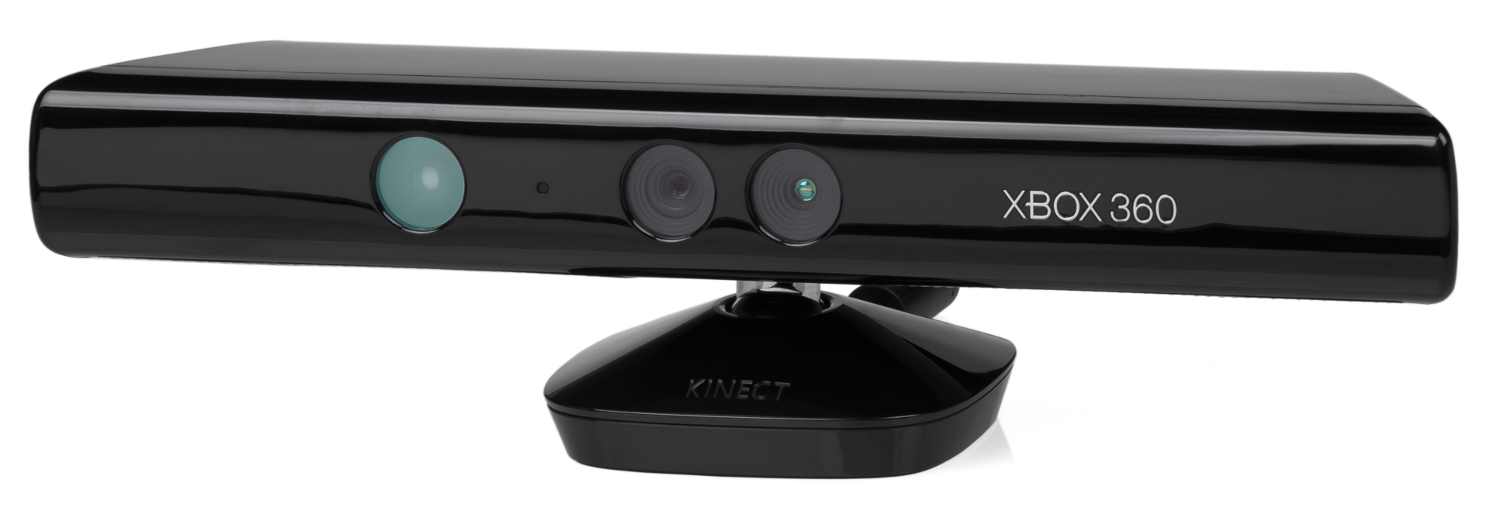
2010
Notes:
Kinect: 2010 - 2017
Von Evan-Amos - Eigenes Werk, Gemeinfrei, https://commons.wikimedia.org/w/index.php?curid=16059165

Slide 17
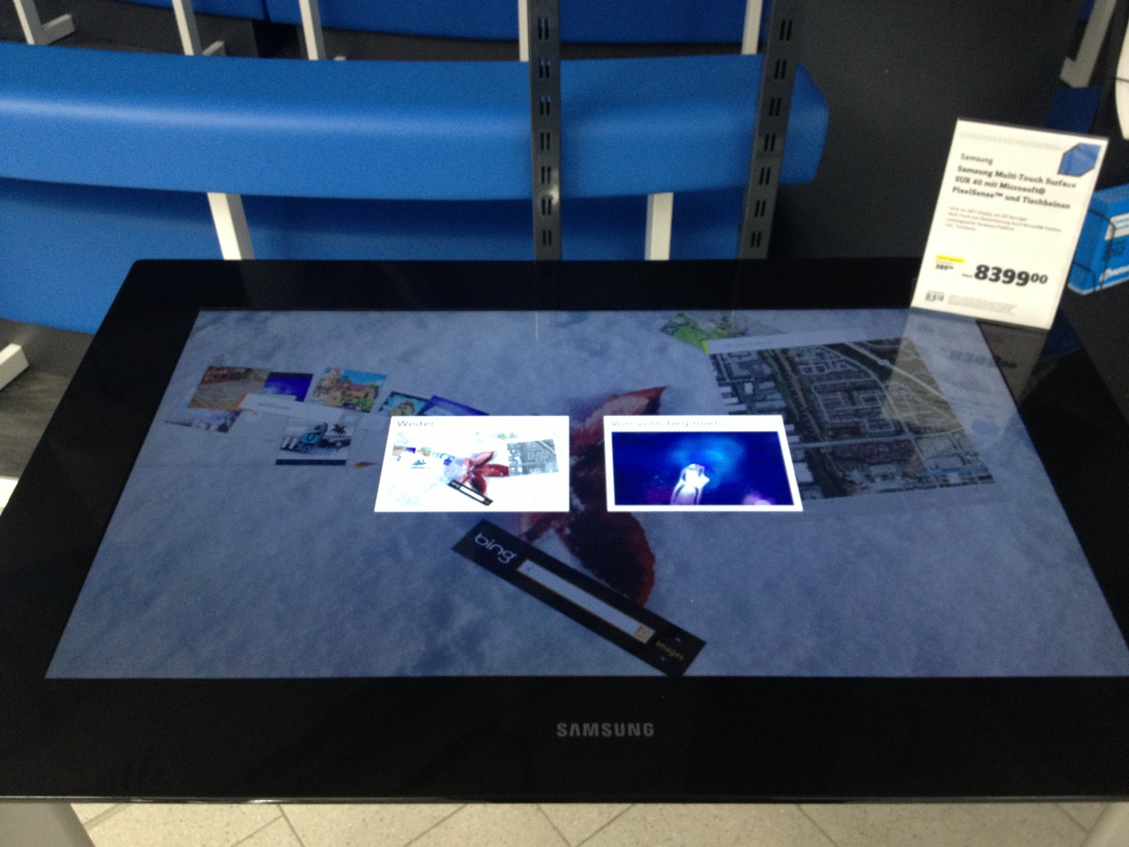
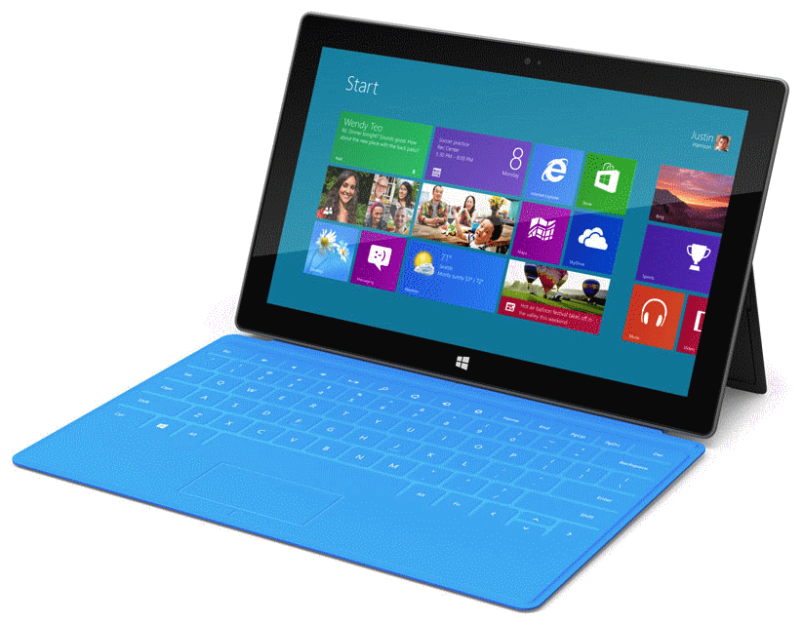
2007
2012
Notes:
Surface/Pixelsense: 2007
Surface RT/Windows RT: 2012 - 2015

Slide 18
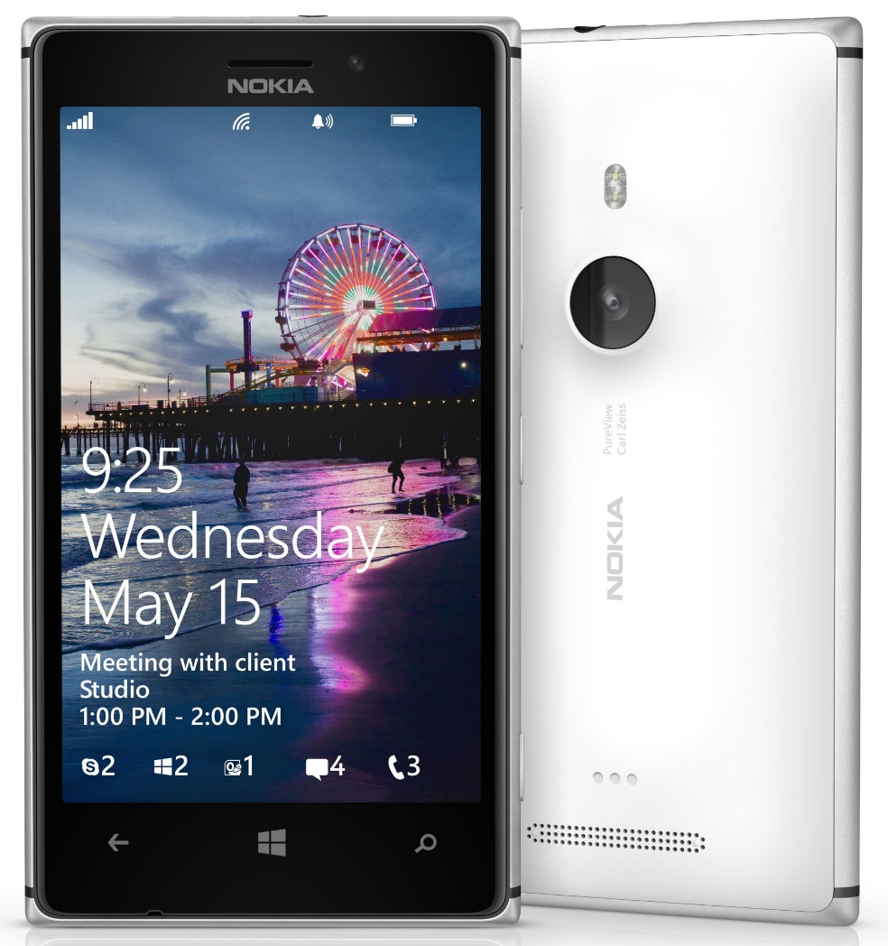
NOKIA@MSFT
2014-2016
Notes:
By Intel Free Press - https://www.flickr.com/photos/intelfreepress/9527140036/sizes/o/in/photostream/, CC BY-SA 2.0, https://commons.wikimedia.org/w/index.php?curid=27914410
https://www.heise.de/newsticker/meldung/Nokia-und-Microsoft-Der-Anfang-vom-Ende-3095504.html

Slide 19
# 2
Quality

Slide 20
# 2
Quality

Slide 21
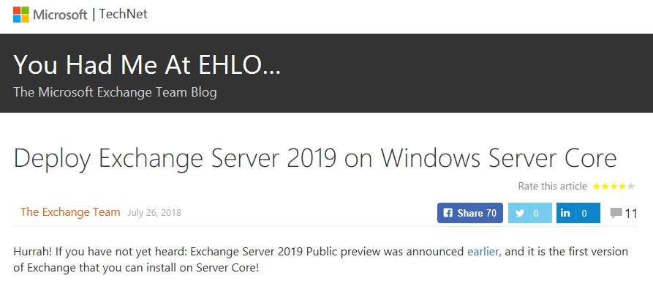
Notes:
https://blogs.technet.microsoft.com/exchange/2018/07/26/deploy-exchange-server-2019-on-windows-server-core/

Slide 22

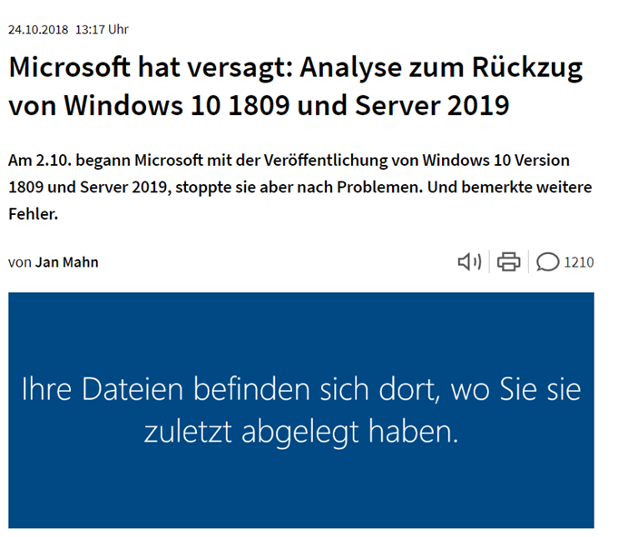

Slide 23

KEEP
CALM
IT'S
DEMO
TIME
Corbel 57, 28

Slide 24

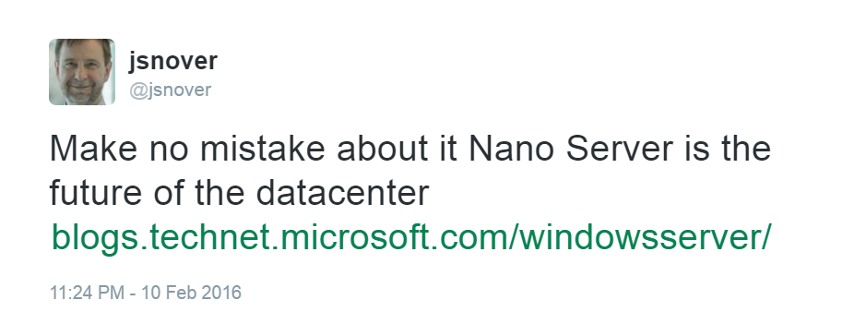
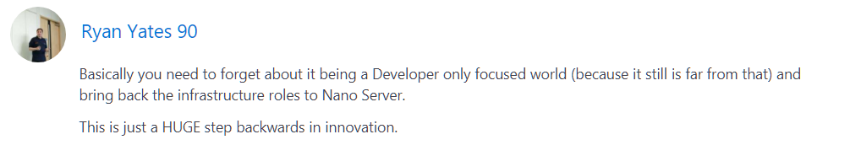
Project Tuva
Erin Chapple (General Manager, Windows Server), 15 Jun 2017
"Based on that feedback, we are making an important change to Nano Server. This next release will focus on making Nano Server the very best container image possible. From these changes, customers will now see the Nano Server images shrink in size by more than 50 percent, further decreasing startup times and improving container density. As part of this effort to focus on containers, we will be removing the functionality for infrastructure-related roles."
Notes:
https://twitter.com/jsnover/status/697546729466392576
https://blogs.technet.microsoft.com/hybridcloud/2017/06/15/delivering-continuous-innovation-with-windows-server/
https://web.archive.org/web/20170701112412/https://blogs.technet.microsoft.com/hybridcloud/2017/06/15/delivering-continuous-innovation-with-windows-server/

Slide 25
# 3
Die Wettervorhersage

Slide 26
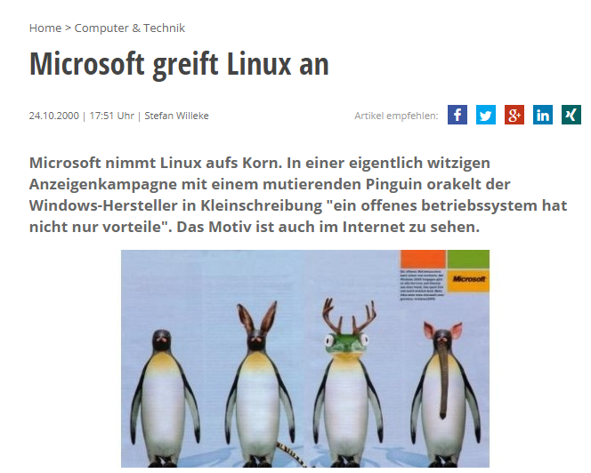
2000
Notes:
https://www.pcwelt.de/news/Microsoft-greift-Linux-an-273131.html

Slide 27
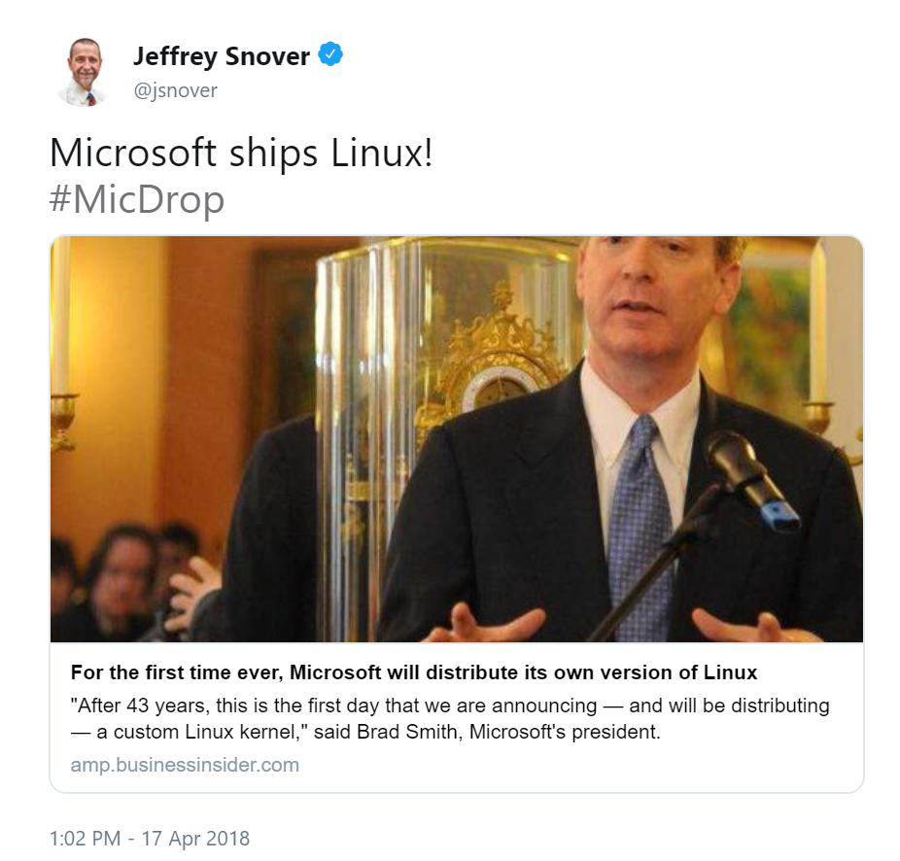
2018
Notes:
https://twitter.com/jsnover/status/986198240013049862
https://amp.businessinsider.com/microsoft-azure-sphere-is-powered-by-linux-2018-4

Slide 28
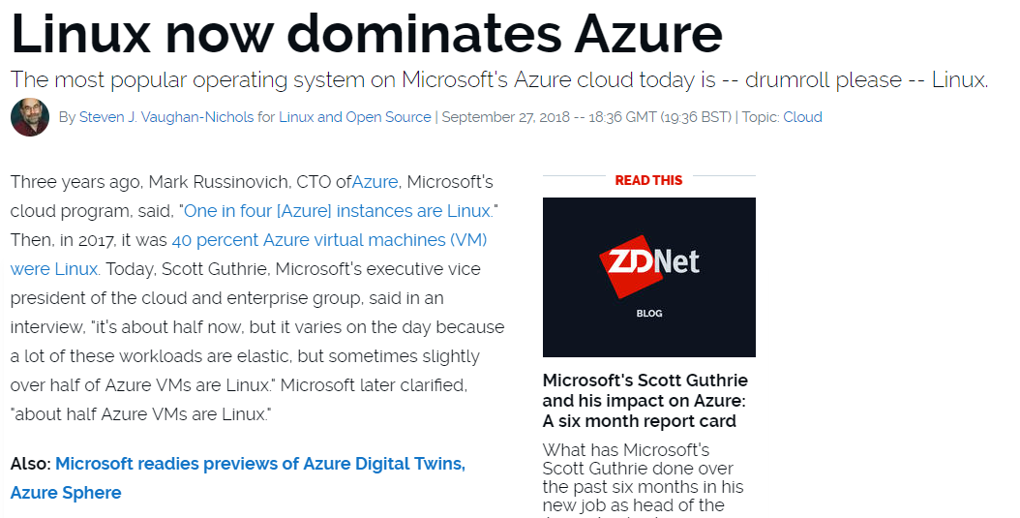

Slide 29
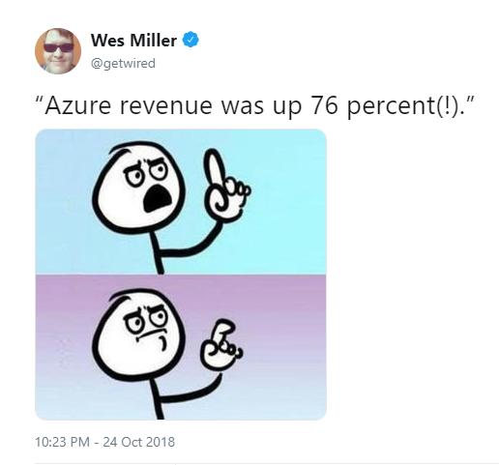
Notes:
https://twitter.com/getwired/status/1055193193480806400

Slide 30
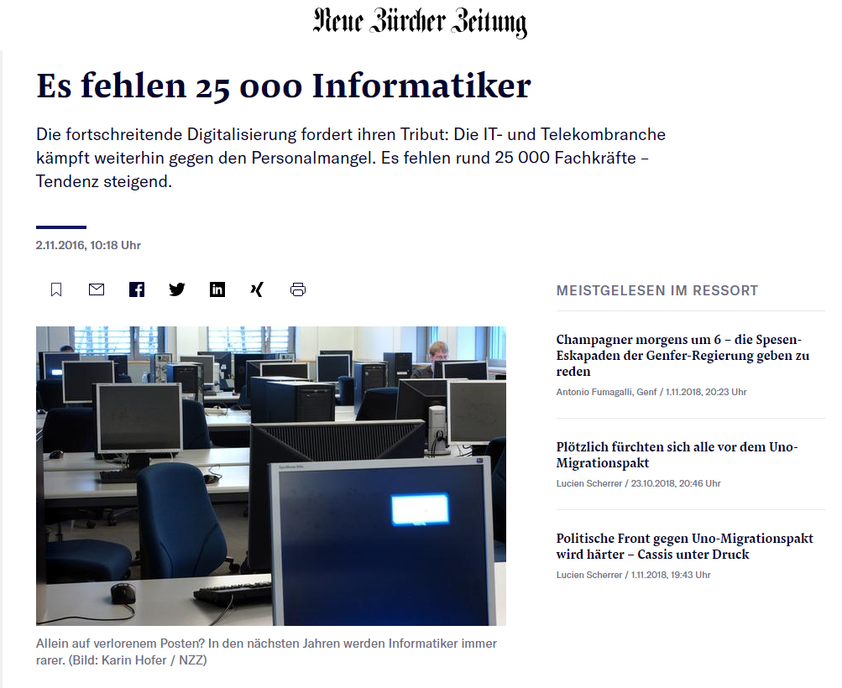
Notes:
https://www.nzz.ch/schweiz/digitalisierung-es-fehlen-25-000-informatiker-ld.125813

Slide 31


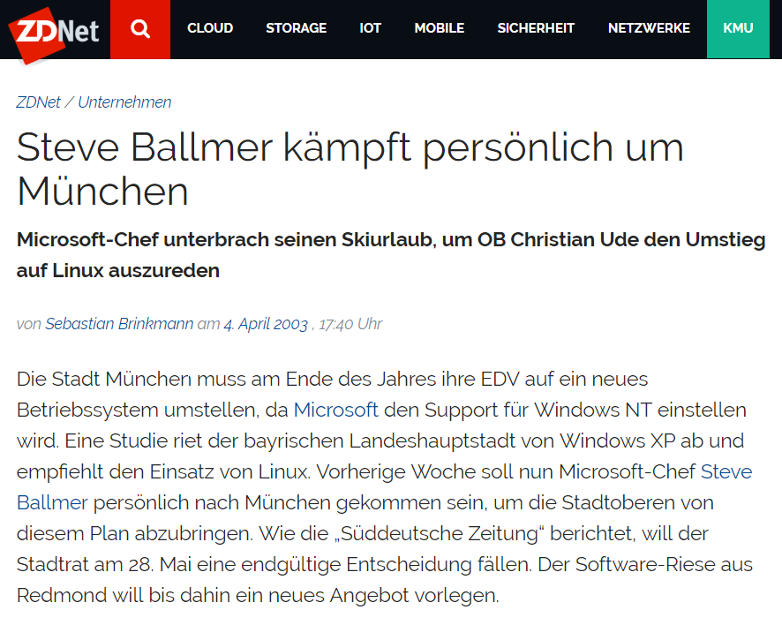
2003
2005
2017
Notes:
https://web.archive.org/web/20060108102532/http://www.muenchen.de/Rathaus/referate/dir/limux/89256/index.html
https://www.heise.de/newsticker/meldung/Muenchen-sucht-Linuxer-104945.html

Slide 32
¯\_(ツ)_/¯

Slide 33
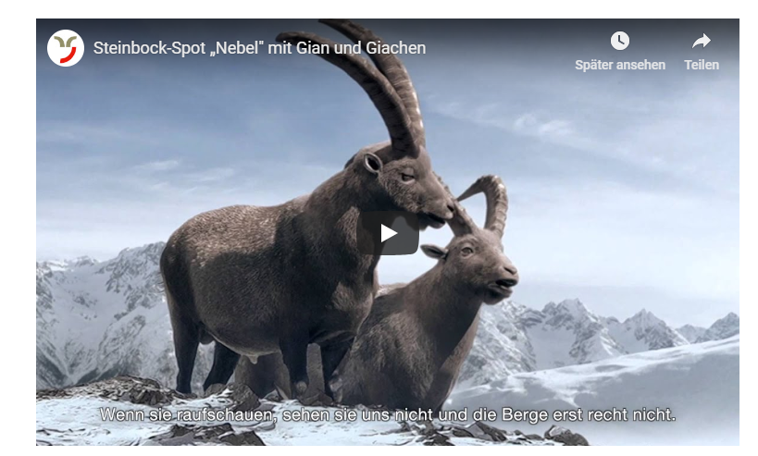
https://www.graubuenden.ch/de/service/steinboecke-gian-und-giachen/steinbock-spots
Notes:
https://www.graubuenden.ch/de/service/steinboecke-gian-und-giachen/steinbock-spots

Slide 34

Notes:
https://fsfe.org/activities/nocloud/

Slide 35
THORSTEN
BUTZ
MICROSOFT
SCHAFFT
SICH AB
Wie wir unsere Infrastruktur
aufs Spiel setzen
GEEKMANIA

